Slide 1
Donor Motivations to Give
Why Donors Give | Structured Gift Case Studies
Dave Smith, CAP®
Founder & CEO
Heaton Smith Group

Slide 2
Gift Planning Donor Motivations to Give

Slide 3
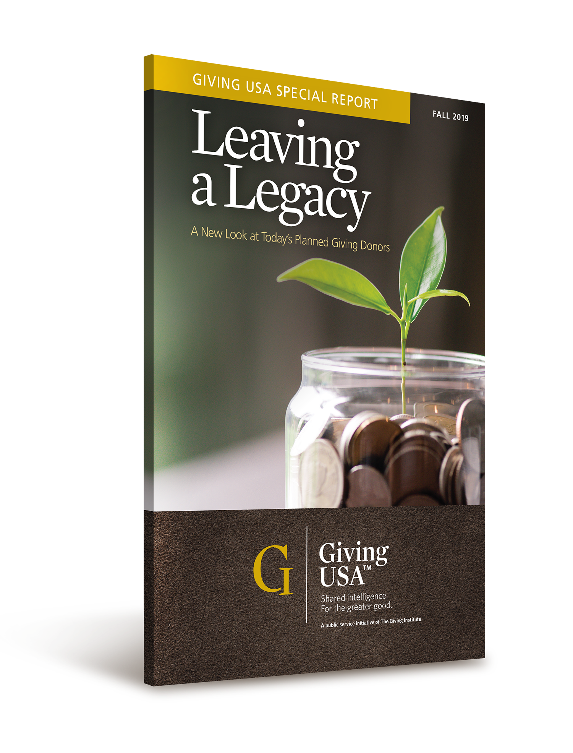
Donor Motivations to Give
Giving USA Foundation: Leaving a Legacy report published in November 2019.
First research study with living planned giving donors in the US since the early 2000s.
Nearly 1000 donors participated across all subsectors except religion.

Slide 4
Importance of Report: Level of Generosity
Gift Type | Mean value of gift, USD | Mean, USD, excluding top 3% | Median value of gift, USD | Median, USD, excluding top 3%
Bequest | $811,535 | $511,874 | $225,000 | $200,000
Retirement plan beneficiary designation | $803,985 | $635,774 | $375,000 | $300,000
Insurance policy | $354,000 | $299,028 | $100,000 | $100,000
*All gift types represented in the report are not included since split interest gifts are not available to donors in Australia.

Slide 5
Donor Motivations
Importance of an organization’s cause
Belief in an organization’s impact on those served
Ability to leave a larger gift at death versus during life
What reason ranked last?
Encouragement of legal or financial advisor.

Slide 6
The Philanthropic Learning Curve
Become a Donor
Get Organized
Become a Learner
Issues and Results Focused
Leverage
Total Alignment
H. Peter Karoff
Founder
The Philanthropic Initiative

Slide 7
Enablers for Gift Planning

Slide 8
Enablers for Gift Planning
Organization demonstrated efficacy and trust.
Organization had established relationship with gift planning donors over time.
Donors had a strong relationship with one or more individuals at the nonprofit(s).
Organization offered meaningful volunteer opportunities.
30 percent of respondents had volunteered for organizations named as a charitable beneficiary.
Donors had served on board and/or committee(s).

Slide 9
Enablers for Gift Planning
Demographics
42.5 percent of respondents in their 50s/60s
52.9 percent of respondents in their 70s/80s
Educated: 90.4 percent of respondents achieved a bachelor’s, master’s, or doctorate degree
70 percent of respondents were married

Slide 10
Enablers to Gift Planning
61% of respondents’ income
ranged from $100K to $499K!
(average annual income in Australia is $91,200/USD $60,185)
@ 2024 Heaton Smith Group

Slide 11
Enablers to Gift Planning
63.4% of respondents’ net worth that ranged from
$1M to $9.9M!
@ 2024 Heaton Smith Group

Slide 12
Enablers to Gift Planning
82.8% of respondents were married, widowed, or divorced/separated.
@ 2024 Heaton Smith Group

Slide 13
What Donor Demographic Makes
the Largest Planned/Blended Gifts?
Married couples with educated children!

Slide 14
Two Most Important Questions
Donors who are not wealthy and have children:
How much inheritance is enough?
Donors who are affluent/wealthy and have children:
How much inheritance is too much? How much money will hurt rather than help our children and other heirs?

Slide 15
Barriers to Gift Planning

Slide 16
Barriers to Gift Planning
Organization exhibits a lack of personal contact and /or follow up
Stewardship practices/alignment fall short
Organization is undergoing mission drift or change in direction
Organization does not ask for deeper engagement or opportunity for involvement

Slide 17
Case Studies

Slide 18
Case Study 1: $2,000,000 Gift
Donor Fact Pattern
Married couple with successful children
Early to mid-seventies
Leading baby boomer
Loyal donors
One spouse on Advancement Council
Husband’s parents were very philanthropic
Interest in naming gift

Slide 19
Case Study 1: $2,000,000 Gift
Gift Pathway
$2,000,000 IRA beneficiary designation
”Seeded” endowment fund with $370,000 of privately held bank stock
Gave the “partial spend”
Gift will endow two full scholarships
Gift agreement
Interest in documented gift to influence other donors
See fruits of their generosity during life

Slide 20
Case Study 5: $100,000 Gift
Donor Fact Pattern
Single female, no children
Early 70s
Leading baby-boomer cohort
Loyal donor
Naming opportunity a high priority
Modest estate

Slide 21
Case Study 5: $100,000 Gift
Gift Pathway
$5,000 annual gift of cash for five years
$100,000 gift from estate
Named hospital as 25% beneficiary of her estate
“Pre-funded” gift with current gift of cash
Named a heart catheterization waiting room

Slide 22
Case Study 3: $750,000 Gift
Donor Fact Pattern
Married with successful child
Early – mid 60s
Trailing baby-boomer cohort
Loyal donors
Both spouses retired
Spouse serves on Foundation board

Slide 23
Case Study 3: $750,000 Gift
Gift Pathway
$150,000 gift of appreciated stock
$600,000 current gift of real estate
Signed gift agreement
Named outreach program for minority children
Reduced size of donors’ estate

Slide 24
Case Study 4: $500,000 Gift
Donor Fact Pattern
Married couple with successful children
Late 50s - 60
Leading baby-boomer cohort
Newly retired
Loyal donors
One spouse a Foundation board member
Very modest lifestyle

Slide 25
Case Study 4: $500,000 Gift
Gift Pathway
$250,000 gift from DAF
$50,000 gift of appreciated stock per year for give years
Timing and impact drove gift decision – accelerated impact through a six-figure gift of cash

Slide 26
Asset Classes
Appreciated Stock
IRA Beneficiary Designation
Real Estate
Donor Advised Fund
Cash

Slide 27
Donor Motivations
Are you doing this?
Or this?
Are you getting donors to pull back the curtain of their life or are they concealing details of their life that are relevant to their fact pattern for a gift.

Slide 28
If you will decide what is important before you decide what to do,
then your children will thrive, your family will survive, and society
will benefit.
Charlie Collier
Harvard University
@ 2024 Heaton Smith Group

Slide 29
Q&A
dave@heatonsmithgroup.com
www.heatonsmithgroup.com
https://www.linkedin.com/company/heaton-smith-group

