Slide 1
Finding meaning in the numbers
Gifts in Wills learning from over 4000 bequests
Notes:
+ Acknowledgment
+ Intro self
+ Intro BA

Slide 2
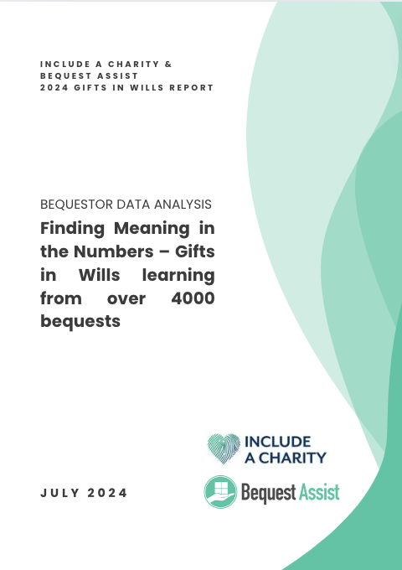
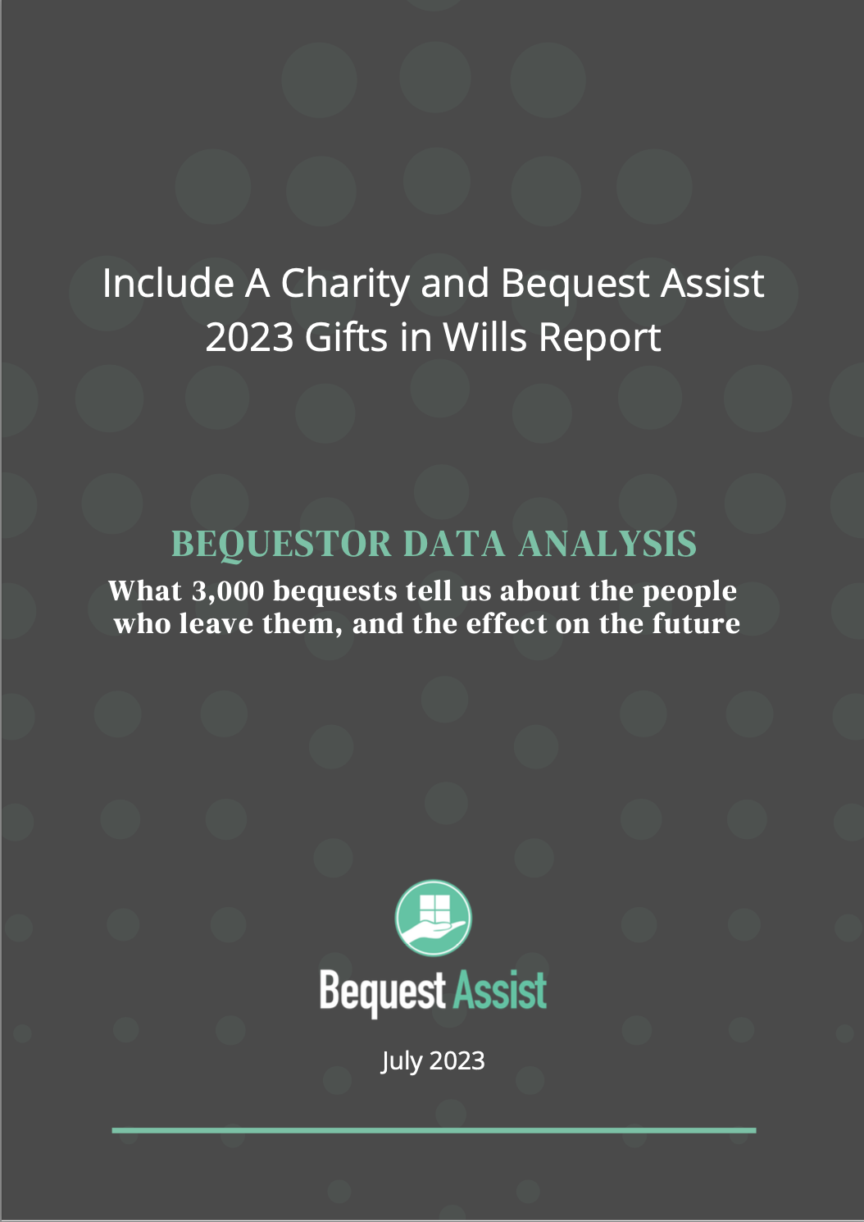
Notes:
+ Findings of report which will be available…
+ Builds on 2023 findings (and new metrics)
+ Thanks to IAC for partnering again
+ Can’t cover everything in report today – more gems in there

Slide 3
Data is collected as part of Bequest Assist’s estate administration
30 Australian charitable entities
Some excluded records
Report covers 4420 bequests across 3662 estates
Baseline to compare against
Notes:
+ Next slide = some basic stats you’re likely familiar with

Slide 4
64% female
68% had no children
Gifts from people without children 4x higher
88% unpartnered
Average age of writing final will = 80
Median average of 3.6 years between writing last will and passing away
Average age at death = 85
Notes:
+ nothing dramatically different from 2023
+ gift likelihood and size diminished by having a partner or children at time of death - I would spend time on individuals with partners but less so people with children (you might get a bequest but pecuniary and small)

Slide 5
Bequestor socio-economic status
Socioeconomic status (out of Australia) | Number of bequests | % of bequests
Bottom third | 660 | 15.83%
Middle third | 931 | 22.33%
Top third | 2578 | 61.84%
Grand Total | 4169 | 100.00%
Notes:
+ Index of Relative Socio-economic Disadvantage (IRSD)
A low score indicates relatively greater disadvantage in general. For example, an area could have a low score if there are:
many households with low income;
many people with no qualifications;
or many people in low skill occupations.
62% of bequests are coming from the top three highest advantage areas. This differs for some charities.
+ 73% of bequests are coming from urban areas which is just higher than the % of population who lives there. Differs between charities.

Slide 6
Snapshot: what year were wills written when charity was notified in 2023?
Notes:
+ New metric
+ Important part of explaining GIW work is that things you do now pay off in 5-20 years
+ Notifications you receive this year is money you get in the next two years. THAT came from wills written in these years.
+ You might see spikes or troughs for your charity in some years – what GIW activities were you doing then? Radio ads, bad media
+ Remember that this is notification timeframes vary – one of those pre 2008 wills was probated in 1994 and the solicitor is only paying out now

Slide 7
Time from last donation to notification
of bequest
Years between last donation and notification | Number of bequests | % of bequests
Under 1 year | 289 | 21.44%
1 - 2 years | 229 | 16.99%
2 - 3 years | 160 | 11.87%
3 - 4 years | 123 | 9.12%
4 - 5 years | 104 | 7.72%
Over 5 years | 443 | 32.86%
Grand Total | 1348 | 100.00%
Notes:
+ New metric
+ Just individuals who were donors before bequest
+ 33% of the time, no donation for 5 years or more.
+ Increasing talk about deidentifying but you would then not know how you knew these people

Slide 8
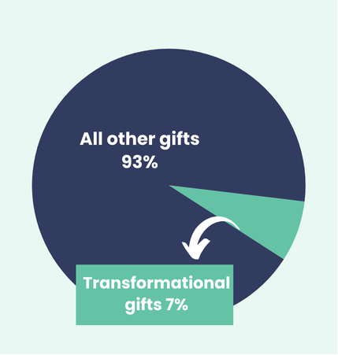
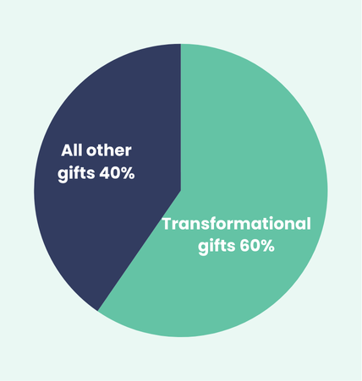
Transformational gifts
Number of transformational gifts
Income from transformational gifts
Notes:
+ But because of large size estate or because of a small estate where they left 100% to a single charity?
+ 56% of these gifts (41% of the income) is coming from estates worth under $3 million total. So it’s not exclusively really high net worth individuals
+ Average estate value is $2 million, or $1 million if looking at median (much higher than general population)
+ we have some charities who frequently receive 100% - not just health charities

Slide 9
Estate assets
48% had shares
65% had real estate
25% had superannuation
Notes:
+ Estates with shares should be managed carefully = CGT + they are 3.4x larger than estates without shares
+ Share median value was $216k
+Real estate is generally largest asset
+ Median value of $825k
+ Super is new - we weren’t seeing it before 2023 but since then, 25% of the time and growing
+ Median value of $289,000
+ Mandatorily taxed and be careful of assuming it is flowing into the estate

Slide 10
Legal issues in estates
FPC average loss of $132,000 or median loss of $45,000
12% of bequests have legal issues
(including 5% with family provision claims)
3.75% total GIW income lost to legal issues
Notes:
+ Caveat – older data is less accurate, includes threatened but not seen through, sometimes estimates
+ 5% with family provision claims = said last year that it was not trending up. Looks like it peaked in 2022 at 8% and now down to 4% in 2023 and 3% in 2024.

Slide 11
Snapshot: are notifications trending up or down?
Notes:
+ New metric
+ Charities want to know if GIW are trending up or down – don’t look at income (transformational gifts skew this), look at notifications
+ Across the board, holding steady, steady growth or substantial growth. Biggest decrease was by two bequests
+ We see as much as 25% variability year on year

Slide 12
Takeaways
Use data to tell the story of GIW being a long game
Where is your time best spent?
Legal issues are not costing as much as we think
Understanding estate assets is essential
Notification trends = good news!

Slide 13
Be part of the movement
www.includeacharity.com.au

